Slide 1
第4章
C#高级编程

Slide 2
异常
某学生小王转帐5000到其朋友小李的帐面上

Slide 3
数据库
系统将查询发送到数据库中
帐户 | 姓名 | 余额
300123 | 小王 | 4500
300124 | 小黄 | 7000
311320 | 小李 | 0
tranfer_money()
{
sendquery();
}
…….
…….
余额＝ 4500-5000
某学生小王转帐5000到其朋友小李的帐面上

Slide 4
数据库
系统将查询发送到数据库中
帐户 | 姓名 | 余额
300123 | 小王 | 4500
300124 | 小黄 | 7000
311320 | 小李 | 0
tranfer_money()
{
sendquery();
}
…….
…….
异常
网上银行
余额＝ 4500-5000
某学生小王转帐5000到其朋友小李的帐面上
程序崩溃

Slide 5
错误与异常
错误：可预见，如对字符串进行数值运算(”aaa”/”bbb”) 。
异常：与程序无关的外部原因造成的偶然事件。如数据表不可用或硬件故障等。

Slide 6
using System;
public class TestExcep
{
public static int Calc(int j)
{
return 100 / j;
}
}
class MyApp
{
public static void Main()
{
TestExcep exTest = new TestExcep();
int dZero = TestExcep.Calc(0);
Console.WriteLine("Result: {0}", dZero);
}
}

Slide 7
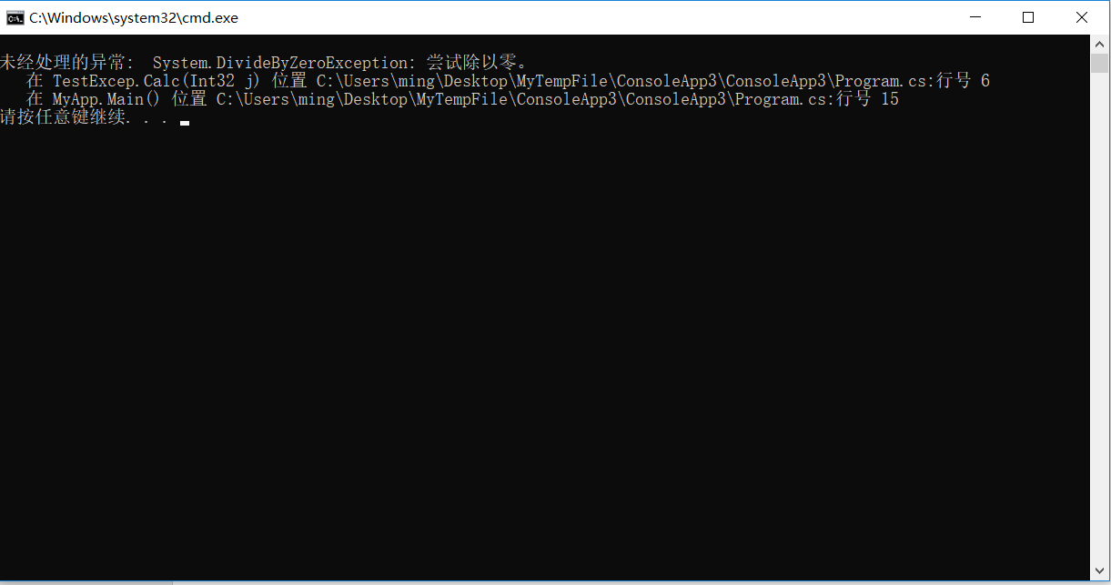
using System;
public class TestExcep
{
public static int Calc(int j)
{
return 100 / j;
}
}
class MyApp
{
public static void Main()
{
TestExcep exTest = new TestExcep();
int dZero = TestExcep.Calc(0);
Console.WriteLine("Result: {0}", dZero);
}
}

Slide 8
System.Exception
引发异常有以下两种方式：
使用显式 throw 语句来引发异常。在此情况下，控制权将无条件转到处理异常的代码
使用语句或表达式在执行过程中激发了某个异常的条件,使得操作无法正常结束,从而引发异常
Try...Catch...Finally

Slide 9
try 和 catch 块
filter_water()
{
try
{
water();
}
catch
{
impurities.Show();
}
}
…….
…….
滤水器
//程序代码
杂质
//错误处理代码
过滤水

Slide 10
try 和 catch 块
try
{
//程序代码
}
catch (IOException E)
{
//错误处理代码
}
filter_water()
{
try
{
water();
}
catch
{
impurities.Show();
}
}
…….
…….
//程序代码
//错误处理代码

Slide 12
try
{
//程序代码
}
catch( )
{
//错误处理代码
}
System.Exception E
可处理系统中的任何一种异常

Slide 13
using System;
public class TestExcep
{
public static int Calc(int j)
{
return 100 / j;
}
}
class MyApp
{
public static void Main()
{
TestExcep exTest = new TestExcep();
try
{
int dZero = TestExcep.Calc(0);
Console.WriteLine("Result: {0}", dZero);
}
catch (DivideByZeroException ex)
{
Console.WriteLine(“divider is 0”);
}
}
}

Slide 14
using System;
public class TestExcep
{
public static int Calc(int j)
{
return 100 / j;
}
}
class MyApp
{
public static void Main()
{
TestExcep exTest = new TestExcep();
try
{
int dZero = TestExcep.Calc(0);
Console.WriteLine("Result: {0}", dZero);
}
catch (DivideByZeroException ex)
{
Console.WriteLine(“divider is 0”);
}
}
}
输出结果：divider is 0

Slide 15
使用finally
try
{
//程序代码
}
catch
{
//错误处理代码
}
finally
{
//finally 代码
}
如果没有catch，则finally必须有。

Slide 16
using System;
public class TestExcep
{
public static int Calc(int j)
{
return 100 / j;
}
}
class MyApp
{
public static void Main()
{
TestExcep exTest = new TestExcep();
try
{
int dZero = TestExcep.Calc(0);
Console.WriteLine("Result: {0}", dZero);
}
catch (DivideByZeroException ex)
{
Console.WriteLine(“divider is 0”);
}
finally
{
Console.WriteLine("Cleanup occurs here");
}
}
}

Slide 17
using System;
public class TestExcep
{
public static int Calc(int j)
{
return 100 / j;
}
}
class MyApp
{
public static void Main()
{
TestExcep exTest = new TestExcep();
try
{
int dZero = TestExcep.Calc(0);
Console.WriteLine("Result: {0}", dZero);
}
catch (DivideByZeroException ex)
{
Console.WriteLine(“divider is 0”);
}
finally
{
Console.WriteLine("Cleanup occurs here");
}
}
}
输出结果：
divider is 0
Cleanup occurs here

Slide 18
using System;
public class TestExcep
{
public static int Calc(int j)
{
return 100 / j;
}
}
class MyApp
{
public static void Main()
{
TestExcep exTest = new TestExcep();
try
{
int dZero = TestExcep.Calc(1);
Console.WriteLine("Result: {0}", dZero);
}
catch (DivideByZeroException ex)
{
Console.WriteLine(“divider is 0”);
}
finally
{
Console.WriteLine("Cleanup occurs here");
}
}
}

Slide 19
using System;
public class TestExcep
{
public static int Calc(int j)
{
return 100 / j;
}
}
class MyApp
{
public static void Main()
{
TestExcep exTest = new TestExcep();
try
{
int dZero = TestExcep.Calc(1);
Console.WriteLine("Result: {0}", dZero);
}
catch (DivideByZeroException ex)
{
Console.WriteLine(“divider is 0”);
}
finally
{
Console.WriteLine("Cleanup occurs here");
}
}
}
输出结果：
Result: 100
Cleanup occurs here

Slide 20
多catch块
try
{
//程序代码
}
catch (IOException E)
{
//错误处理代码
}
catch (OutOfMemoryException E)
{
//错误处理代码
}
用于捕捉两种异常的catch块

Slide 21
using System;
public class TestExcep
{
public static int Calc(int j)
{
return 100 / j;
}
}
class MyApp
{
public static void Main()
{
TestExcep exTest = new TestExcep();
try
{
int dZero = TestExcep.Calc(0);
Console.WriteLine("Result: {0}", dZero);
}
catch (Exception ex)
{
Console.WriteLine("Exception”);
}
catch (DivideByZeroException ex)
{
Console.WriteLine("DivideByZeroException");
}
finally
{
Console.WriteLine("Cleanup occurs here");
}
}
}

Slide 22
using System;
public class TestExcep
{
public static int Calc(int j)
{
return 100 / j;
}
}
class MyApp
{
public static void Main()
{
TestExcep exTest = new TestExcep();
try
{
int dZero = TestExcep.Calc(0);
Console.WriteLine("Result: {0}", dZero);
}
catch (Exception ex)
{
Console.WriteLine("Exception”);
}
catch (DivideByZeroException ex)
{
Console.WriteLine("DivideByZeroException");
}
finally
{
Console.WriteLine("Cleanup occurs here");
}
}
}
上一个 catch 子句已经捕获了此类型或超类型(“System.Exception”)的所有异常 。
特定异常→一般异常

Slide 23
System.Exception类
属性
Message获取描述当前异常的消息。
Source获取或设置导致错误的应用程序或对象的名称(程序集的名称)。
TargetSite获取引发当前异常的方法。
StackTrace获取当前异常发生时调用堆栈上的帧的字符串表示形式。

Slide 24
//005.cs
using System;
public class TestExcep
{
public static int Calc(int j)
{
return 100 / j;
}
}
class MyApp
{
public static void Main()
{
TestExcep exTest = new TestExcep();
try
{
int dZero = TestExcep.Calc(0);
Console.WriteLine("Result: {0}", dZero);
}
catch (DivideByZeroException ex)
{
Console.WriteLine("ex.Message: {0}", ex.Message);
Console.WriteLine("ex.Source: {0}", ex.Source);
Console.WriteLine("ex.TargetSite: {0}", ex.TargetSite.ToString());
Console.WriteLine("ex.StackTrace: {0}", ex.StackTrace);
}
catch (Exception ex)
{
Console.WriteLine("General " + ex.Message);
}
finally
{
Console.WriteLine("Cleanup occurs here");
}
}
}

Slide 25
//005.cs
using System;
public class TestExcep
{
public static int Calc(int j)
{
return 100 / j;
}
}
class MyApp
{
public static void Main()
{
TestExcep exTest = new TestExcep();
try
{
int dZero = TestExcep.Calc(0);
Console.WriteLine("Result: {0}", dZero);
}
catch (DivideByZeroException ex)
{
Console.WriteLine("ex.Message: {0}", ex.Message);
Console.WriteLine("ex.Source: {0}", ex.Source);
Console.WriteLine("ex.TargetSite: {0}", ex.TargetSite.ToString());
Console.WriteLine("ex.StackTrace: {0}", ex.StackTrace);
}
catch (Exception ex)
{
Console.WriteLine("General " + ex.Message);
}
finally
{
Console.WriteLine("Cleanup occurs here");
}
}
}
ex.Message: 尝试除以零。
ex.Source: 005
ex.TargetSite: Int32 Calc(Int32)
ex.StackTrace: 在 TestExcep.Calc(Int32 j) 位置 F:\005\Program.cs:行号 6
在 MyApp.Main() 位置 F:\005\Program.cs:行号 17
Cleanup occurs here

Slide 26
如何创建定制异常类
类应从ApplicationException派生
应尽可能包含Exception基类定义的三个公共构造函数：
默认的无参数构造函数；
带一个字符串参数(通常是消息)的构造函数；
带一个字符串和一个Exception对象参数的构造函数，处理异常时如果又发生异常，就会使用第二个参数。
使用基类初始化调用(base)来初始化对象。如果要初始化额外字段或成员属性，则要增加新的构造函数来初始化这些值。

Slide 27
if (grade< 0 && grade > 150)
{
throw new InvalidNumberInput
(grade+ “不是合法的成绩”);
}
throw 可用来引发自定义异常“InvalidNumberInput”

Slide 28
public interface IFun1
{ string ShowMe();}
public interface IFun2
{ string ShowMe(); }
class Circle : IFun1
{
public string ShowMe()
{ return "Circle-IFun1"; }
}
public class MyApp
{
static void Main()
{
IFun2 i = new Circle() as IFun2;
Console.WriteLine(i.ShowMe());
IFun1 i2 = new Circle() as IFun1;
Console.WriteLine(i2.ShowMe());
}
}

Slide 29
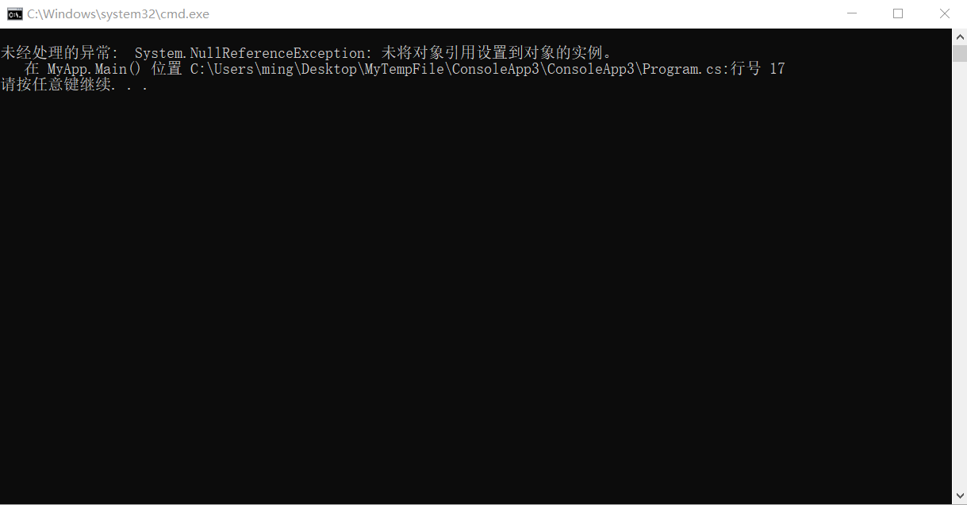
public interface IFun1
{ string ShowMe();}
public interface IFun2
{ string ShowMe(); }
class Circle : IFun1
{
public string ShowMe()
{ return "Circle-IFun1"; }
}
public class MyApp
{
static void Main()
{
IFun2 i = new Circle() as IFun2;
Console.WriteLine(i.ShowMe());
IFun1 i2 = new Circle() as IFun1;
Console.WriteLine(i2.ShowMe());
}
}

Slide 30
using System;
public class NoDescException : ApplicationException
{
public NoDescException() { }
public NoDescException(string message) : base(message) { }
public NoDescException(string message, Exception ex) : base(message, ex) { }
}
public interface IFun1
{ string ShowMe();}
public interface IFun2
{ string ShowMe(); }
class Circle : IFun1
{
public string ShowMe()
{ return "Circle-IFun1"; }
}
public class MyApp
{
static void Main()
{
try
{
Circle c = new Circle();
if (!(c is IFun2))
throw new NoDescException("Interface not implemented for " + c.ToString());
IFun2 i = new Circle() as IFun2;
Console.WriteLine(i.ShowMe());
}
catch (NoDescException e)
{
Console.WriteLine(e.Message);
}
IFun1 i2 = new Circle() as IFun1;
Console.WriteLine(i2.ShowMe());
}
}

Slide 31
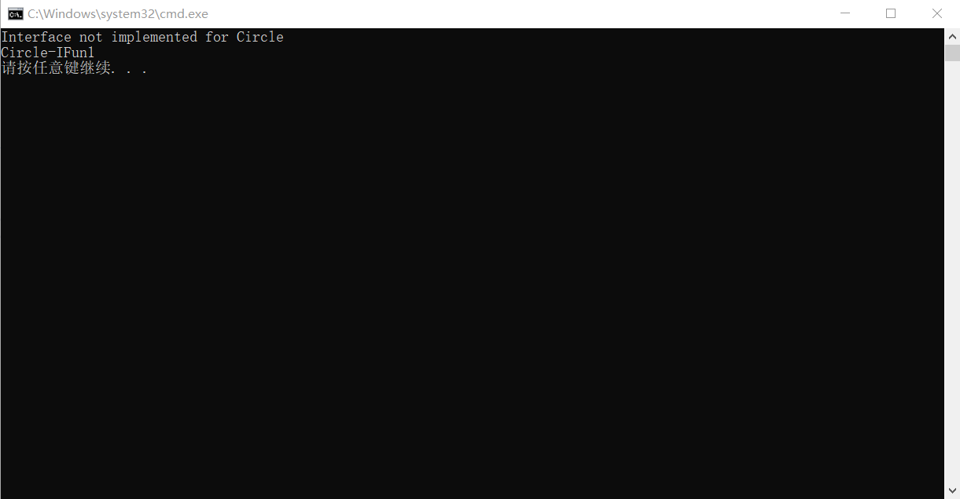

Slide 32
实例
数据库
系统将查询发送到数据库中
帐户 | 姓名 | 余额
300123 | 小王 | 4500
300124 | 小黄 | 7000
311320 | 小李 | 0
tranfer_money()
{
sendquery();
}
…….
…….
余额＝ 4500-5000
某学生小王转帐5000到其朋友小李的帐面上

Slide 33
public class User
{
public double leftMoney;
public User(double a) { leftMoney = a; }
}
public class MyApp
{
static void TransferMoney(User from, User to, double m)
{
to.leftMoney += m;
from.leftMoney -= m;
}
static void Main()
{
User xiaoWang = new User(4000);
User xiaoLi = new User(0);
TransferMoney(xiaoWang, xiaoLi, 5000);
}
}

Slide 34
public class MoneyNotSufficient : ApplicationException
{
public MoneyNotSufficient(string message) : base(message) { }
}
static void TransferMoney(User from, User to, double m)
{
try
{
if (from.leftMoney < m)
throw new MoneyNotSufficient("The remaining money is not sufficient");
to.leftMoney += m;
from.leftMoney -= m;
}
catch(MoneyNotSufficient e)
{
Console.WriteLine(e.Message);
}
}

Slide 35
using System;
public class MoneyNotSufficient : ApplicationException
{
public MoneyNotSufficient(string message) : base(message) { }
}
public class User
{
public double leftMoney;
public User(double a) { leftMoney = a; }
}
public class MyApp
{
static void TransferMoney(User from, User to, double m)
{
try
{
if (from.leftMoney < m)
throw new MoneyNotSufficient("The remaining money is not sufficient");
to.leftMoney += m;
from.leftMoney -= m;
}
catch(MoneyNotSufficient e)
{
Console.WriteLine(e.Message);
}
}
static void Main()
{
User xiaoWang = new User(4000);
User xiaoLi = new User(0);
TransferMoney(xiaoWang, xiaoLi, 5000);
}
}

Slide 36
未处理异常
using System;
class MyApp
{
static int f(int i)
{
return 100 / i;
}
public static void Main()
{
try
{
int dZero = f(0);
}
finally
{
Console.WriteLine("finally");
}
}
}

Slide 37
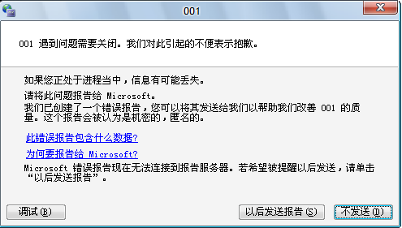
using System;
class MyApp
{
static int f(int i)
{
return 100 / i;
}
public static void Main()
{
try
{
int dZero = f(0);
}
finally
{
Console.WriteLine("finally");
}
}
}

Slide 38
定制处理未处理异常
Windows窗体应用：
Applicatioin.ThreadException +=
new ThreadExceptionEventHandler(method);
Windows控制台应用：
Thread.GetDomain().UnhandledException +=
new UnhandledExceptionEventHandler(method);

Slide 39
using System;
using System.Threading;
public class TestExcep
{
public static int Calc(int j)
{ return 100 / j; }
}
public class UnForgiven
{
public static void MyUnhandleMethod(object sender, UnhandledExceptionEventArgs e)
{
Console.WriteLine(e.ToString());
}
}
class MyApp
{
public static void Main()
{
Thread.GetDomain().UnhandledException += new UnhandledExceptionEventHandler(UnForgiven.MyUnhandleMethod);
try
{ int dZero = TestExcep.Calc(0); }
finally
{ Console.WriteLine("a"); }
}
}

Slide 40
using System;
using System.Threading;
public class TestExcep
{
public static int Calc(int j)
{ return 100 / j; }
}
public class UnForgiven
{
public static void MyUnhandleMethod(object sender, UnhandledExceptionEventArgs e)
{
Console.WriteLine(e.ToString());
}
}
class MyApp
{
public static void Main()
{
Thread.GetDomain().UnhandledException += new UnhandledExceptionEventHandler(UnForgiven.MyUnhandleMethod);
try
{ int dZero = TestExcep.Calc(0); }
finally
{ Console.WriteLine("a"); }
}
}
System.UnhandledExceptionEventArgs

Slide 41
using System;
using System.Threading;
public class TestExcep
{
public static int Calc(int j)
{ return 100 / j; }
}
public class UnForgiven
{
public static void MyUnhandleMethod(object sender, UnhandledExceptionEventArgs e)
{
Console.WriteLine(e.ToString());
}
}
class MyApp
{
public static void Main()
{
Thread.GetDomain().UnhandledException += new UnhandledExceptionEventHandler(UnForgiven.MyUnhandleMethod);
try
{ int dZero = TestExcep.Calc(0); }
finally
{ Console.WriteLine("a"); }
}
}
System.UnhandledExceptionEventArgs

Slide 42
定制类中实现System.Object方法
ToString()
public virtual string ToString ();
返回类名
覆盖此方法，显示出对象与访类其他实例不同的特有内容。
Equals()
public virtual bool Equals (object obj);
值类型：根据值的大小判断
引用类型：根据引用的地址判断

Slide 43
定制ToString()
默认返回classname
using System.Text;
using System;
public class Chair
{
private double myPrice;
private string myVendor, myID;
public Chair(double price, string vendor, string sku)
{
myPrice = price;
myVendor = vendor;
myID = sku;
}
static void Main()
{
Chair myChair = new Chair(120.0, "Broyhill", "60-1222");
Console.WriteLine(myChair.ToString());
}
}

Slide 44
默认返回classname
using System.Text;
using System;
public class Chair
{
private double myPrice;
private string myVendor, myID;
public Chair(double price, string vendor, string sku)
{
myPrice = price;
myVendor = vendor;
myID = sku;
}
static void Main()
{
Chair myChair = new Chair(120.0, "Broyhill", "60-1222");
Console.WriteLine(myChair.ToString());
}
}
输出：
Chair

Slide 45
using System.Text;
using System;
public class Chair
{
private double myPrice;
private string myVendor, myID;
public Chair(double price, string vendor, string sku)
{
myPrice = price;
myVendor = vendor;
myID = sku;
}
public override string ToString()
{
string str1 = "ITEM = Chair";
string str2 = string.Format("\tVENDOR = {0}", myVendor);
string str3 = string.Format("\tPRICE = {0}", myPrice.ToString());
return str1 + str2 + str3;
}
static void Main()
{
Chair myChair = new Chair(120.0, "Broyhill", "60-1222");
Console.WriteLine(myChair.ToString());
}
}

Slide 46
using System.Text;
using System;
public class Chair
{
private double myPrice;
private string myVendor, myID;
public Chair(double price, string vendor, string sku)
{
myPrice = price;
myVendor = vendor;
myID = sku;
}
public override string ToString()
{
string str1 = "ITEM = Chair";
string str2 = string.Format("\tVENDOR = {0}", myVendor);
string str3 = string.Format("\tPRICE = {0}", myPrice.ToString());
return str1 + str2 + str3;
}
static void Main()
{
Chair myChair = new Chair(120.0, "Broyhill", "60-1222");
Console.WriteLine(myChair.ToString());
}
}
ITEM = Chair VENDOR = Broyhill PRICE = 120

Slide 47
定制Equals()
比较两个引用类型的对象时，当它们指向相同的对象，返回true。
如果基于值来比较引用对象时，必须覆盖该方法。String类就是这样一个例子，其虽然是引用类型，但它会基于字符串中的字符串完成比较。

Slide 48
覆盖GetHashCode()
GetHashCode方法
对象生成一个Int32类型的散列码。
.NET要求两个相同的对象必须有相同的散列码，不同的对象不保证有不同的散列码。
Equals方法必须和GetHashCode方法成对出现。

Slide 49
实例
using System;
public class Chair
{
private double myPrice;
private string myVendor, myID;
public Chair(double price, string vendor, string sku)
{
myPrice = price;
myVendor = vendor;
myID = sku;
}
static void Main()
{
Chair myChair = new Chair(120.0, "Broyhill", "60-1222");
Chair newChair = new Chair(120.0, "Broyhill", "60-1222");
bool eq = myChair.Equals(newChair);
Console.WriteLine(eq.ToString());
}
}

Slide 50
using System;
public class Chair
{
private double myPrice;
private string myVendor, myID;
public Chair(double price, string vendor, string sku)
{
myPrice = price;
myVendor = vendor;
myID = sku;
}
public override bool Equals(object obj)
{
bool isEqual = true;
if (obj == null) isEqual= false;
if (this.GetType() != obj.GetType()) isEqual= false; //判断引用指向的对象类型是否相同
Chair otherObj = (Chair)obj;
if (!myVendor.Equals(otherObj.myVendor)) isEqual= false;
if (!myID.Equals(otherObj.myID)) isEqual= false;
if (!myPrice.Equals(otherObj.myPrice)) isEqual= false;
return isEqual;
}
public override int GetHashCode()
{ return myID.GetHashCode(); }
static void Main()
{
Chair myChair = new Chair(120.0, "Broyhill", "60-1222");
Chair newChair = new Chair(120.0, "Broyhill", "60-1222");
bool eq = myChair.Equals(newChair);
Console.WriteLine(eq.ToString());
}
}

Slide 51
克隆来创建对象副本
Object中的MemberwiseClone()
默认返回对象的一个副本，是一种浅拷贝。
protected object MemberwiseClone();
可以实现自己的克隆方法进行深拷贝。
不能克隆基本类型。可克隆的类必须实现ICloneable接口。
public interface ICloneable
{
object Clone();
}

Slide 52
using System;
public class Chair : ICloneable
{
private double myPrice;
private string myVendor, myID;
public Upholstery myUpolstery;
public Chair(double price, string vendor, string sku)
{
myPrice = price;
myVendor = vendor;
myID = sku;
myUpolstery = new Upholstery(myID);
}
public Object Clone()
{
return MemberwiseClone();
}
}
public class Upholstery
{
public string fabric;
public Upholstery(string fab)
{ fabric = fab; }
}
class MyApp
{
static void Main()
{
Chair myChair = new Chair(120.0, "Broyhill", "60-1222");
Chair chairClone = (Chair)myChair.Clone();
bool isEqual;
isEqual = Object.ReferenceEquals(myChair, chairClone);
Console.WriteLine(isEqual.ToString());
isEqual = Object.ReferenceEquals(myChair.myUpolstery, chairClone.myUpolstery);
Console.WriteLine(isEqual.ToString());
}
}

Slide 53
using System;
public class Chair : ICloneable
{
private double myPrice;
private string myVendor, myID;
public Upholstery myUpolstery;
public Chair(double price, string vendor, string sku)
{
myPrice = price;
myVendor = vendor;
myID = sku;
myUpolstery = new Upholstery(myID);
}
public Object Clone()
{
return MemberwiseClone();
}
}
public class Upholstery
{
public string fabric;
public Upholstery(string fab)
{ fabric = fab; }
}
False
True
class MyApp
{
static void Main()
{
Chair myChair = new Chair(120.0, "Broyhill", "60-1222");
Chair chairClone = (Chair)myChair.Clone();
bool isEqual;
isEqual = Object.ReferenceEquals(myChair, chairClone);
Console.WriteLine(isEqual.ToString());
isEqual = Object.ReferenceEquals(myChair.myUpolstery, chairClone.myUpolstery);
Console.WriteLine(isEqual.ToString());
}
}

Slide 55
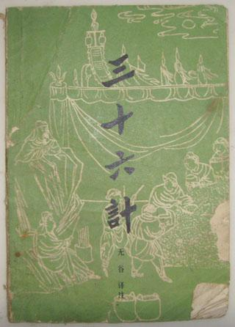
什么是设计模式
模式就是很好的成功范例。
走为上
围魏救赵
声东击西
设计模式是软件开发过程中积累的经验
经过实践检验的，特定问题的优秀解决方法

Slide 56
简单工厂模式
父类产品
客户
子类产品A
子类产品B
子类产品C
工厂
工厂类：担任这个角色的是工厂方法模式的核心。工厂类在客户端的直接调用下创建产品对象，它往往由一个具体的类实现。
抽象产品角色：担任这个角色的类是由工厂方法模式所创建的对象的父类，或她们共同拥有的接口。一般由接口或抽象类实现。
具体产品角色：工厂方法模式所创建的任何对象都是这个角色的实例，由具体类实现。

Slide 57
public interface IApparel
{
string ShowMe();
}
客户
父类产品
子类产品A
子类产品C
工厂

Slide 58
public interface IApparel
{
string ShowMe();
}
public class SportShirt: IApparel
{
public string ShowMe()
{
return (“Sports Shirt”);
}
}
客户
父类产品
子类产品A
子类产品C
工厂

Slide 59
public interface IApparel
{
string ShowMe();
}
public class SportShirt: IApparel
{
public string ShowMe()
{
return (“Sports Shirt”);
}
}
客户
父类产品
public class DressShirt: IApparel
{
public string ShowMe()
{
return (“Dress Shirt”);
}
}
子类产品A
子类产品C
工厂

Slide 60
public class ApparelFactory
{
public IApparel CreateApparel (string apptype)
{
switch(apptype)
{
case “DRESSSHIRT”:
return new DressShirt();
case “SPORTSSHIRT”:
return new SportShirt();
}
return null;
}
}
客户
父类产品
子类产品A
子类产品C
工厂

Slide 61
客户代码
//创建工厂实例
ApparelFactory factory= new ApparelFactory();
//工厂生产产品（抽象产品）
IApparel obj1 = factory.CreateApparel(“DRESSSHIRT”);
IApparel obj2 = factory.CreateApparel(“SPORTSSHIRT”);
//通过抽象产品获取具体产品的信息
string shirtType = obj1.ShowMe();

Slide 62
例：简单工厂模式实现计算两个数的加、减、乘、除。

Slide 63
public interface ICalculator {
double GetResult(double a, double b);
}

Slide 64
public interface ICalculator {
double GetResult(double a, double b);
}
public class AddCalculator : ICalculator {
public double GetResult(double a, double b) {
Console.WriteLine("add: ");
return a + b;
}
}
public class SubstractCalculator : ICalculator {
public double GetResult(double a, double b) {
Console.WriteLine("substract: ");
return a - b;
}
}
public class MultiplyCalculator : ICalculator {
public double GetResult(double a, double b) {
Console.WriteLine("multiply: ");
return a * b;
}
}
public class DivideCalculator : ICalculator {
public double GetResult(double a, double b) {
Console.WriteLine("divide: ");
if(b !=0) return a / b;
else return 0;
}
}

Slide 65
public interface ICalculator {
double GetResult(double a, double b);
}
public class AddCalculator : ICalculator {
public double GetResult(double a, double b) {
Console.WriteLine("add: ");
return a + b;
}
}
public class SubstractCalculator : ICalculator {
public double GetResult(double a, double b) {
Console.WriteLine("substract: ");
return a - b;
}
}
public class MultiplyCalculator : ICalculator {
public double GetResult(double a, double b) {
Console.WriteLine("multiply: ");
return a * b;
}
}
public class DivideCalculator : ICalculator {
public double GetResult(double a, double b) {
Console.WriteLine("divide: ");
if(b !=0) return a / b;
else return 0;
}
}
public class CalFactory {
public ICalculator CreateCalculator(string opt) {
switch(opt) {
case "+":
return new AddCalculator();
case "-":
return new SubstractCalculator();
case "*":
return new MultiplyCalculator();
case "/":
return new DivideCalculator();
}
return null;
}
}

Slide 66
class Program {
static void Main(string[] args) {
double a = 10, b = 20, r;
CalFactory fac = new CalFactory();
ICalculator cal = fac.CreateCalculator("+");
r = cal.GetResult(a, b);
Console.WriteLine("result: " + r);
cal = fac.CreateCalculator("-");
r = cal.GetResult(a, b);
Console.WriteLine("result: " + r);
cal = fac.CreateCalculator("*");
r = cal.GetResult(a, b);
Console.WriteLine("result: " + r);
cal = fac.CreateCalculator("/");
r = cal.GetResult(a, b);
Console.WriteLine("result: " + r);
}
}

Slide 67
简单工厂模式优缺点
父类产品
客户
子类产品A
子类产品B
子类产品C
工厂
优点：
模式的核心是工厂类，这个类负责产品的创建，而客户端可以免去产品创建的责任，这实现了责任的分割。
客户只需指示工厂创建哪个对象。
缺点：
但由于工厂类集中了所有产品创建逻辑，如果不能正常工作的话会对系统造成很大的影响。如果增加新产品必须修改工厂角色的源码。

Slide 68
什么是抽象工厂设计模式
客户
抽象工厂
抽象产品A
实体工厂B
实体工厂A
实体产品A2
实体产品A1
抽象产品B
实体产品B2
实体产品B1

Slide 69

：抽象工厂设计模式中各个象的主要功能、职责
1、用抽象工厂生产抽象产品
2、用实体工厂生产实体产品
3、用抽象产品提供实体产品访问接口
4、用实体产品实现自己的功能
抽象工厂
客户请求
抽象产品

Slide 70
抽象工厂角色：担任这个角色的是工厂方法模式的核心，是工厂的父类。通常使用接口或抽象类实现。
具体工厂角色：这个角色直接在客户端的调用下创建产品的实例。这个角色含有选择合适的产品对象的逻辑，而这个逻辑是与应用系统的商业逻辑紧密相关的。通常使用具体的类实现。
抽象产品角色：担任这个角色的类是创建的对象的父类，或它们共同拥有的接口。通常使用接口或抽象类实现这一角色。
具体产品角色：抽象工厂模式所创建的任何产品对象都是某一具体产品类的实例。这是客户端最终需要的东西。通常使用具体类实现这个角色。

Slide 71
应用示例
客户
抽象工厂
抽象产品
礼服衬衫实体工厂
运动衫实体工厂
运动衫
实
体产品
礼服衬衫实
体产品
public abstract class AppFactory
{
public abstract IApparel CreateApparel();
}

Slide 72
应用示例
public class DressShirtFactory : AppFactory
{
public override IApparel CreateApparel()
{
return new DressShirt();
}
}
客户
抽象工厂
抽象产品
礼服衬衫实体工厂
运动衫实体工厂
运动衫
实
体产品
礼服衬衫实
体产品
public abstract class AppFactory
{
public abstract IApparel CreateApparel();
}

Slide 73
应用示例
public class SportShirtFactory : AppFactory
{
public override IApparel CreateApparel()
{
return new SportsShirt();
}
}
客户
抽象工厂
抽象产品
礼服衬衫实体工厂
运动衫实体工厂
运动衫
实
体产品
礼服衬衫实
体产品
public abstract class AppFactory
{
public abstract IApparel CreateApparel();
}

Slide 74
客户代码
//创建工厂实例
AppFactory factory = new DressShirtFactory();
//通过抽象工厂生产产品（抽象产品）
IApparel obj = factory.CreateApparel();
//通过抽象产品获取具体产品的信息
string shirtType = obj.ShowMe();

Slide 75
class Program {
static void Main(string[] args) {
double a = 10, b = 20, r;
CalFactory fac = new CalFactory();
ICalculator cal = fac.CreateCalculator("+");
r = cal.GetResult(a, b);
Console.WriteLine("result: " + r);
cal = fac.CreateCalculator("-");
r = cal.GetResult(a, b);
Console.WriteLine("result: " + r);
cal = fac.CreateCalculator("*");
r = cal.GetResult(a, b);
Console.WriteLine("result: " + r);
cal = fac.CreateCalculator("/");
r = cal.GetResult(a, b);
Console.WriteLine("result: " + r);
}
}
例：抽象工厂模式实现计算两个数的加、减、乘、除。

Slide 76
public interface ICalculator {
double GetResult(double a, double b);
}
public class AddCalculator : ICalculator {
public double GetResult(double a, double b) {
Console.WriteLine("add: ");
return a + b;
}
}
public class SubstractCalculator : ICalculator {
public double GetResult(double a, double b) {
Console.WriteLine("substract: ");
return a - b;
}
}
public class MultiplyCalculator : ICalculator {
public double GetResult(double a, double b) {
Console.WriteLine("multiply: ");
return a * b;
}
}
public class DivideCalculator : ICalculator {
public double GetResult(double a, double b) {
Console.WriteLine("divide: ");
if(b !=0) return a / b;
else return 0;
}
}

Slide 77
public interface ICalFactory {
ICalculator CreateCalculator();
}
public class AddFactory : ICalFactory {
public ICalculator CreateCalculator() {
return new AddCalculator();
}
}
public class SubstractFactory : ICalFactory {
public ICalculator CreateCalculator() {
return new SubstractCalculator();
}
}
public class MultiplyFactory : ICalFactory {
public ICalculator CreateCalculator() {
return new MultiplyCalculator();
}
}
public class DivideFactory : ICalFactory {
public ICalculator CreateCalculator() {
return new DivideCalculator();
}
}

Slide 78
class Program
{
static void Main(string[] args)
{
double a = 10, b = 20, r;
ICalFactory fac = new AddFactory();
r = fac.CreateCalculator().GetResult(a, b);
Console.WriteLine("result: " + r);
fac = new SubstractFactory();
r = fac.CreateCalculator().GetResult(a, b);
Console.WriteLine("result: " + r);
fac = new MultiplyFactory();
r = fac.CreateCalculator().GetResult(a, b);
Console.WriteLine("result: " + r);
fac = new DivideFactory();
r = fac.CreateCalculator().GetResult(a, b);
Console.WriteLine("result: " + r);
}
}

Slide 79
class Program
{
static void Main(string[] args)
{
double a = 10, b = 20, r;
ICalFactory fac = new AddFactory();
r = fac.CreateCalculator().GetResult(a, b);
Console.WriteLine("result: " + r);
fac = new SubstractFactory();
r = fac.CreateCalculator().GetResult(a, b);
Console.WriteLine("result: " + r);
fac = new MultiplyFactory();
r = fac.CreateCalculator().GetResult(a, b);
Console.WriteLine("result: " + r);
fac = new DivideFactory();
r = fac.CreateCalculator().GetResult(a, b);
Console.WriteLine("result: " + r);
}
}
class Program {
static void Main(string[] args) {
double a = 10, b = 20, r;
CalFactory fac = new CalFactory();
ICalculator cal = fac.CreateCalculator("+");
r = cal.GetResult(a, b);
Console.WriteLine("result: " + r);
cal = fac.CreateCalculator("-");
r = cal.GetResult(a, b);
Console.WriteLine("result: " + r);
cal = fac.CreateCalculator("*");
r = cal.GetResult(a, b);
Console.WriteLine("result: " + r);
cal = fac.CreateCalculator("/");
r = cal.GetResult(a, b);
Console.WriteLine("result: " + r);
}
}
抽象工厂模式
简单工厂模式

Slide 80
反射 using System.Reflection;
可以ILDasm反编译工具浏览一个dll和exe的构成
这种机制叫做反射（Reflection）
应用程序信息
类的属性
应用程序或dll
类的方法
反射
…
用于在运行时通过编程方式获得类型信息

Slide 81
通过代码获取程序的版本号
引入命名空间
using System.Reflection;
using System;
class Program
{
static void Main(string[] args)
{
string version = Assembly.LoadFile(@"F:\ConsoleApplication1.exe")
.GetName().Version.ToString();
Console.WriteLine(version);
}
}
反射
1.0.0.0

Slide 82
新增TShirtProduct产品？
public interface IApparel {
string ShowMe();
}
public class SportShirtProduct : IApparel {
public string ShowMe() {
return ("Sports Shirt");
}
}
public class DressShirtProduct : IApparel {
public string ShowMe() {
return ("Dress Shirt");
}
}
public class ApparelFactory {
public IApparel CreateApparel(string apptype) {
switch (apptype) {
case "DRESSSHIRT":
return new DressShirtProduct();
case "SPORTSSHIRT":
return new SportShirtProduct();
}
return null;
}
}

Slide 83
新增TShirtProduct产品？
public interface IApparel {
string ShowMe();
}
public class SportShirtProduct : IApparel {
public string ShowMe() {
return ("Sports Shirt");
}
}
public class DressShirtProduct : IApparel {
public string ShowMe() {
return ("Dress Shirt");
}
}
public class ApparelFactory {
public IApparel CreateApparel(string apptype) {
switch (apptype) {
case "DRESSSHIRT":
return new DressShirtProduct();
case "SPORTSSHIRT":
return new SportShirtProduct();
case “TSHIRT":
return new TShirtProduct();
}
return null;
}
}
public class ApparelFactory {
public IApparel CreateApparel(string apptype) {
switch (apptype) {
case "DRESSSHIRT":
return new DressShirtProduct();
case "SPORTSSHIRT":
return new SportShirtProduct();
}
return null;
}
}

Slide 84
反射创建对象
public interface IApparel {
string ShowMe();
}
public class SportShirtProduct : IApparel {
public string ShowMe() {
return ("Sports Shirt");
}
}
public class DressShirtProduct : IApparel {
public string ShowMe() {
return ("Dress Shirt");
}
}
public class ApparelFactory {
public IApparel CreateApparel(string apptype) {
switch (apptype) {
case "DRESSSHIRT":
return new DressShirtProduct();
case "SPORTSSHIRT":
return new SportShirtProduct();
}
return null;
}
}
public class Program
{
static void Main(string[] args)
{
Assembly ass = Assembly.GetExecutingAssembly();
DressShirtProduct obj = ass.CreateInstance("DressShirtProduct") as DressShirtProduct;
Console.WriteLine(obj.ShowMe());
}
}

Slide 85
public interface IApparel {
string ShowMe();
}
public class SportShirtProduct : IApparel {
public string ShowMe() {
return ("Sports Shirt");
}
}
public class DressShirtProduct : IApparel {
public string ShowMe() {
return ("Dress Shirt");
}
}
public class TShirtProduct : IApparel {
public string ShowMe() {
return (“T Shirt");
}
}
新增TShirtProduct产品？
public class ApparelFactory {
public IApparel CreateApparel(string apptype) {
……..
}
}

Slide 86
public interface IApparel {
string ShowMe();
}
public class SportShirtProduct : IApparel {
public string ShowMe() {
return ("Sports Shirt");
}
}
public class DressShirtProduct : IApparel {
public string ShowMe() {
return ("Dress Shirt");
}
}
public class TShirtProduct : IApparel {
public string ShowMe() {
return (“T Shirt");
}
}
public class ApparelFactory {
public IApparel CreateApparel(string apptype) {
Assembly ass = Assembly.GetExecutingAssembly();
IApparel ia = ass.CreateInstance(apptype) as IApparel;
return ia;
}
}

Slide 87
public class ApparelFactory {
public IApparel CreateApparel(string apptype) {
Assembly ass = Assembly.GetExecutingAssembly();
IApparel ia = ass.CreateInstance(apptype) as IApparel;
return ia;
}
}
public class Program {
static void Main(string[] args) {
IApparel obj = (new ApparelFactory()).CreateApparel("TShirtProduct");
Console.WriteLine(obj.ShowMe());
}
}

Slide 88
获取程序集中的类型
public interface IApparel {
string ShowMe();
}
public class SportShirtProduct : IApparel {
public string ShowMe() {
return ("Sports Shirt");
}
}
public class DressShirtProduct : IApparel {
public string ShowMe() {
return ("Dress Shirt");
}
}
public class Program
{
static void Main(string[] args)
{
Assembly ass = Assembly.GetExecutingAssembly();
Type[] mytypes = ass.GetTypes();
Console.WriteLine("列出程序集中的所有类型");
foreach (Type t in mytypes)
{
Console.WriteLine(t.Name);
}
}
}
public class ApparelFactory {
public IApparel CreateApparel(string apptype) {
switch (apptype) {
case "DRESSSHIRT":
return new DressShirtProduct();
case "SPORTSSHIRT":
return new SportShirtProduct();
}
return null;
}
}
列出程序集中的所有类型
IApparel
SportShirtProduct
DressShirtProduct
ApparelFactory
Program

Slide 89
工厂类自动创建程序集中的所有产品？
public interface IApparel {
string ShowMe();
}
public class SportShirtProduct : IApparel {
public string ShowMe() {
return ("Sports Shirt");
}
}
public class DressShirtProduct : IApparel {
public string ShowMe() {
return ("Dress Shirt");
}
}

Slide 90
获取程序集中的类型
public interface IApparel {
string ShowMe();
}
public class SportShirtProduct : IApparel {
public string ShowMe() {
return ("Sports Shirt");
}
}
public class DressShirtProduct : IApparel {
public string ShowMe() {
return ("Dress Shirt");
}
}
public class Program
{
static void Main(string[] args)
{
Assembly ass = Assembly.GetExecutingAssembly();
Type[] mytypes = ass.GetTypes();
Console.WriteLine("列出程序集中的所有类型");
foreach (Type t in mytypes)
{
Console.WriteLine(t.Name);
}
}
}
public class ApparelFactory {
public IApparel CreateApparel(string apptype) {
switch (apptype) {
case "DRESSSHIRT":
return new DressShirtProduct();
case "SPORTSSHIRT":
return new SportShirtProduct();
}
return null;
}
}
列出程序集中的所有类型
IApparel
SportShirtProduct
DressShirtProduct
ApparelFactory
Program

Slide 91
工厂类自动创建程序集中的所有产品？
public interface IApparel {
string ShowMe();
}
public class SportShirtProduct : IApparel {
public string ShowMe() {
return ("Sports Shirt");
}
}
public class DressShirtProduct : IApparel {
public string ShowMe() {
return ("Dress Shirt");
}
}
005.cs→005.exe
public class Program
{
static void Main(string[] args)
{
}
}

Slide 92
工厂类自动创建程序集中的所有产品
public class ApparelFactory {
public IApparel[] CreateApparel() {
IApparel [] ia = null;
Assembly ass = Assembly.LoadFile("005.exe");
Type[] mytypes = ass.GetTypes();
int productN = 0;
foreach (Type t in mytypes) {
if (t.Name.Contains("Product")) {
++productN;
}
}
ia = new IApparel[productN];
int index = 0;
foreach(Type t in mytypes) {
if (t.Name.Contains("Product")) {
ia[index++] = ass.CreateInstance(t.Name) as IApparel;
}
}
return ia;
}
}

Slide 93
public class Program
{
static void Main(string[] args)
{
IApparel[] objs = (new ApparelFactory()).CreateApparel();
foreach (IApparel ia in objs)
{
Console.WriteLine(ia.ShowMe());
}
}
}
Sports Shirt
Dress Shirt

Slide 94
工厂类自动创建程序集中的所有产品？
public interface IApparel {
string ShowMe();
}
public class SportShirtProduct : IApparel {
public string ShowMe() {
return ("Sports Shirt");
}
}
public class DressShirtProduct : IApparel {
public string ShowMe() {
return ("Dress Shirt");
}
}
public interface IApparel {
string ShowMe();
}
public class SportShirtProduct : IApparel {
public string ShowMe() {
return ("Sports Shirt");
}
}
public class DressShirtProduct : IApparel {
public string ShowMe() {
return ("Dress Shirt");
}
}
public class TShirtProduct : IApparel {
public string ShowMe() {
return (“T Shirt");
}
}
public class Program
{
static void Main(string[] args)
{
}
}
005.cs→005.exe

Slide 95
工厂类自动创建程序集中的所有产品
public class ApparelFactory {
public IApparel[] CreateApparel() {
IApparel [] ia = null;
Assembly ass = Assembly.LoadFile("005.exe");
Type[] mytypes = ass.GetTypes();
int productN = 0;
foreach (Type t in mytypes) {
if (t.Name.Contains("Product")) {
++productN;
}
}
ia = new IApparel[productN];
int index = 0;
foreach(Type t in mytypes) {
if (t.Name.Contains("Product")) {
ia[index++] = ass.CreateInstance(t.Name) as IApparel;
}
}
return ia;
}
}

